Slide 1
Energy-efficient nanoelectronics using giant spin-orbit materials
Comprehensive Viva
27 August 2021
Priyesh Kumar
Roll: 1910705, Email: priyesh19@iiserb.ac.in
Electrical Engineering and Computer Science (EECS) Dept.
Indian Institute of Science Education and Research (IISER) Bhopal
Advisor: Dr. Kuntal Roy, Email: kuntal@iiserb.ac.in

Slide 2
Contents
Introduction
Spintronics and nanomagnetics
Magnetic anisotropy
Magneto-resistance
Magnetization dynamics
Switching using magnetic field
Spin-transfer-torque
Spin Hall effect and spin-orbit-torque
Ferromagnetic resonance and spin pumping
Plan of works
Probing the resistivity of ultra-thin spin-orbit materials
Spin-torque ferromagnetic resonance
Switch magnetization using spin-orbit-torque
Experimental
Electron beam lithography (EBL) and scanning electron microscope (SEM)
Transmission electron microscope (TEM)
Atomic/Magnetic force microscope (AFM/MFM)
Ferromagnetic resonance (FMR)
Vibrating sample magnetometer (VSM)
Electrical characterization using probe station and accessories
Four-probe setup
Signal generator, oscilloscope, spectrum analyser, bias-tee and power supply
X-Ray diffraction (XRD)
Sputtering

Slide 3
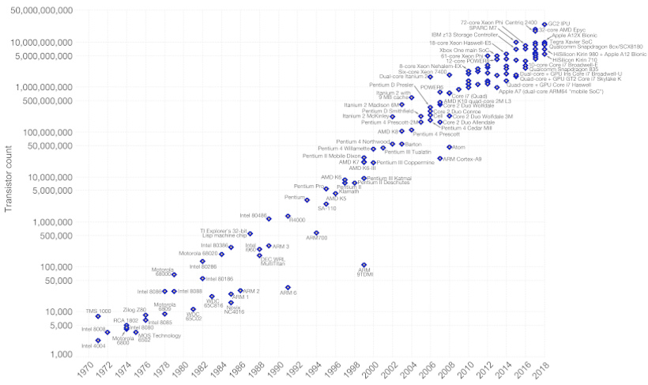
Electronics: Development and Future
Transistor counts 1970-2018 & Moore’s Law
Issues
Energy dissipation
Process variation
Transistor as a
binary switch
Moore’s Law
Gordon Moore
Intel Co-Founder
Number of transistors
DOUBLES in every TWO years
Notes:
Line edge and random dopant fluctuation
Density doubles in every two years, number of transistor per unit area

Slide 4
Electronics: Development and Future
Transistor counts 1970-2018 & Moore’s Law
Issues
Energy dissipation
Process variation
Transistor as a
binary switch
Bohr: Our research group has screened some of these options. This will not only help Intel, but it will help the university research groups identify the more promising options that we should collectively invest in. It may change as more researchers weigh in, but the conclusion at this point is that spintronics may have better chance in the future.
Moore’s Law
Gordon Moore
Intel Co-Founder
Number of transistors
DOUBLES in every TWO years
Mark Bohr, a senior fellow at Intel
http://semiengineering.com/one-on-one-mark-bohr/ (2014)
Notes:
Line edge and random dopant fluctuation
Density doubles in every two years, number of transistor per unit area

Slide 5
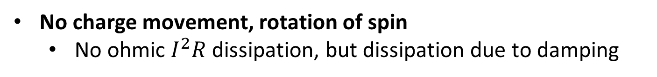
Spintronics: Spin-Electronics
Apart from having charge, an electron has spin
Spin
Up/Down 0/1 (binary information)
Charge
Electron
A rapidly developing nanotechnology
Store, non-volatile
Process
Communicate
In-built functionality
E _{barrier}
No charge movement, rotation of spin
No ohmic $I^{2}R$ dissipation, but dissipation due to damping
Key Issue
There is dissipation due to applying charge voltage/current
Notes:
Spin is the intrinsic angular momentum of an elementary particle as being the result of its rotation about its own axis
In Spintronics, information is stored and transmitted using another property of electrons called spin.
Electrons moving through a nonmagnetic material normally have random spins, so the net effect is zero. External magnetic fields can be applied so that the spins are aligned (all up or all down), allowing a new way to store binary data in the form of one’s (all spins up) and zeroes (all spins down).

Slide 6
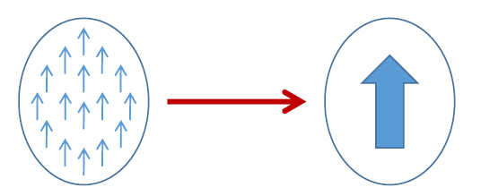
Single-domain nanomagnets
Exchange interaction
Pauli’s exclusion principle
Coulomb repulsion
Each electron small magnet
Ferromagnet
Ferrimagnet
Antiferromagnet
W.F. Brown Jr.,
The fundamental theorem of the ferromagnetic particle theory
Magnetic domain formation should be limited to very small dimensions (100 nm) because of the competition between the magnetostatic energy and the quantum-mechanical exchange energy, causing nanomagnets to behave like single giant spins.
Electron beam lithography (EBL)
Notes:
Single domain nanomagnets are formed due to exchange interaction, which is a simultaneous action of Pauli’s exclusion principle and Coulomb repulsion.

Slide 7
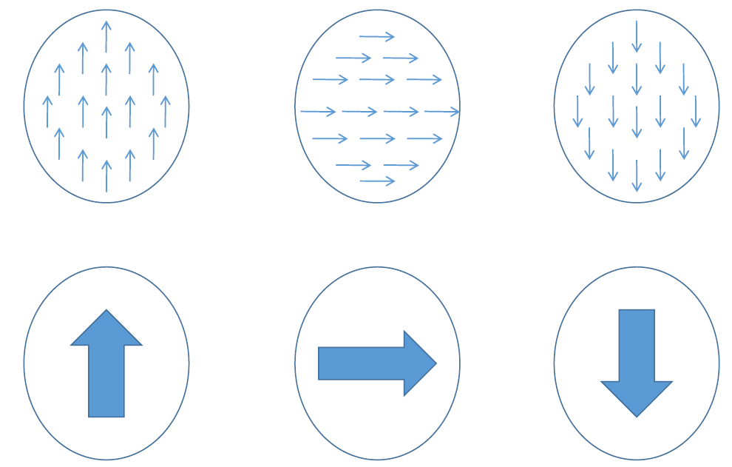
Macrospin/Giant spin
All the spins rotate in unison

Slide 8
Charge current versus spin current
Charge current = 8
Spin current = 0
Charge current = 6
Spin current = 2
Charge current = 0
Spin current = 2
J_{s}
Charge
Spin
Spin-orbit coupling
Pt, Ta, W, CuBi
Charge current
Spin-polarized current
Pure spin current
Notes:
Here I am going to present similarities and differences between charge current and spin current.

Slide 9


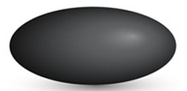
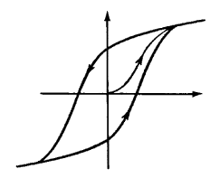
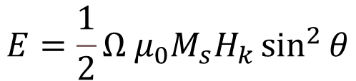
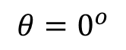
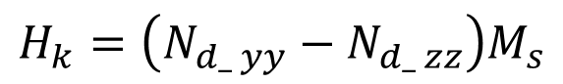
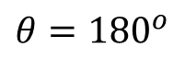
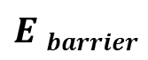
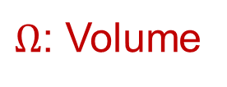
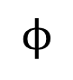
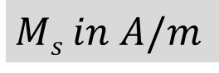
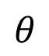
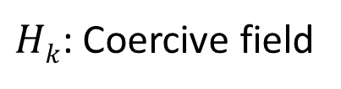
Magnetic anisotropy
x
30-80 KT at 300K
In-plane
Shape anisotropy
Magnetization
$$ϕ$$
$$θ$$
z
$$E barrier$$
y
CoFeB
$$H_{k}=\left(N_{d_ yy}−N_{d_ zz}\right)M_{s}$$
$$θ={180}^{o}$$
$$θ=0^{o}$$
Perpendicular anisotropy
Ellipsoid
$$E=\frac{1}{2}{Ω μ}_{0}M_{s}H_{k}\sin^{2}{θ}$$
CoCrPt
Mgo
$Hk$: Coercive field
B
CoFeB
$Ω$: Volume
t_{CoFeB}<1.3 nm
$$Ms in A/m$$
H
Bulk
Interface
H_{k}
Notes:
If volume increases then E barrier also increases, because of that spontaneous fluctuation minimizes.
$N_{d−yy}$ id demagnetization factor

Slide 10


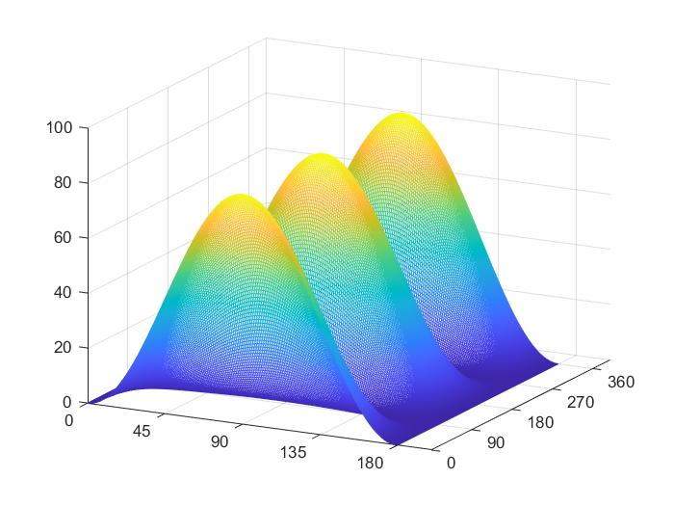
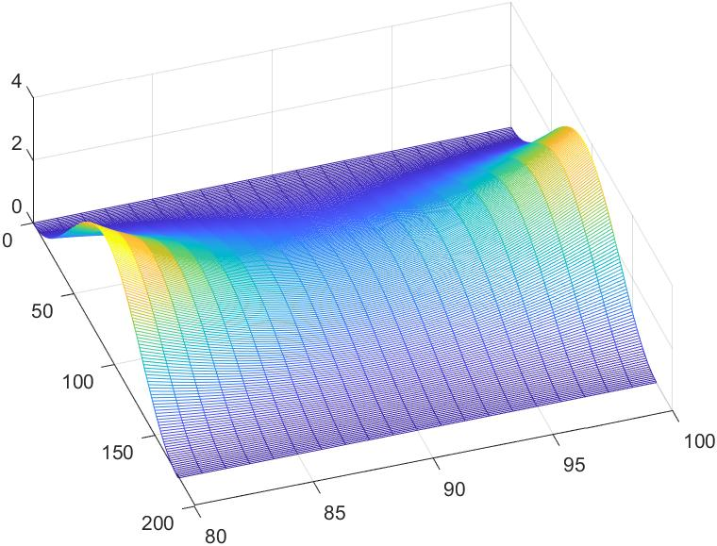
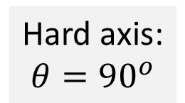
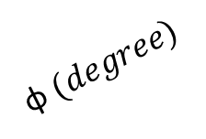
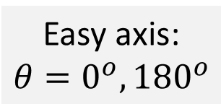
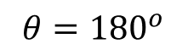
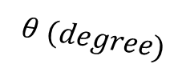
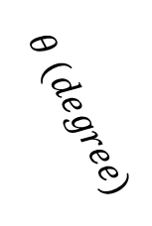
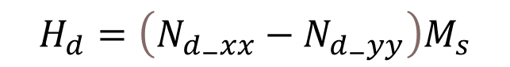
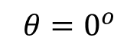
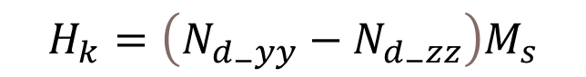
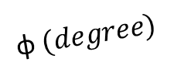
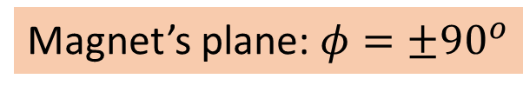
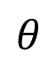
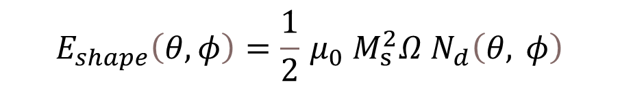
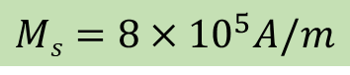
3D potential landscape of nanomagnet
$$E_{shape}\left(θ,φ\right)=\frac{1}{2}{ μ}_{0 }M_{s }^{2}Ω{ N}_{d}\left(θ, φ\right)$$
$$N_{d}\left(θ,φ\right)=N_{d−xx}\sin^{2}{θ}\cos^{2}{φ}+{N_{d−yy}\sin^{2}{θ}sin}^{2}{φ}+{N_{d−zz} cos}^{2}{θ}$$
z
$$H_{k}=\left(N_{d_{−}yy}−N_{d_{−}zz}\right)M_{s}$$
Easy axis:
$$θ=0^{o},{180}^{o}$$
$$θ=0^{o}$$
z
$$H_{d}=\left(N_{d_{−}xx}−N_{d_{−}yy}\right)M_{s}$$
y
$$θ$$
Hard axis:
$$θ={90}^{o}$$
Magnetization direction
x
$$θ={180}^{o}$$
y
Magnet’s plane: $φ=±90^{o}$
φ
Out of plane energy
barrier goes higher
x
$$Ms=8×{10}^{5}A/m$$
Potential energy
Potential energy
$$θ (degree)$$
$$θ (degree)$$
$$\text{φ} (degree)$$
$$\text{φ} (degree)$$

Slide 11


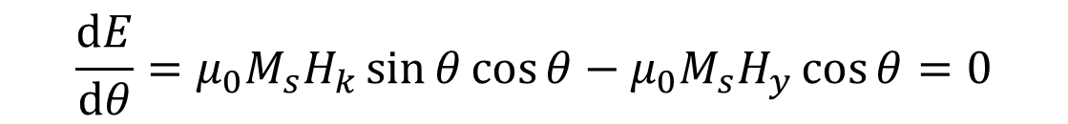
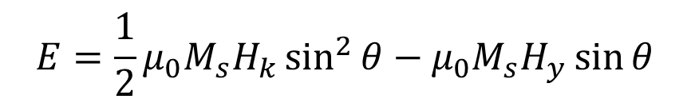
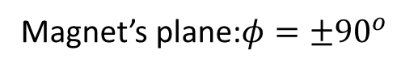
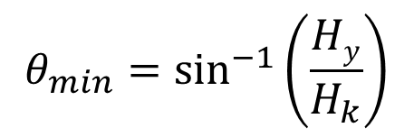
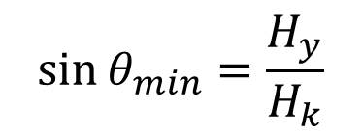
Magnetic Field, H: Simplified 2D analysis
x
z
z
Magnetization
direction
z
$$θ$$
y
y
y
x
φ
x
Magnet’s plane:$φ=±90^{o}$
$$E=\frac{1}{2}μ_{0}M_{s}H_{k}\sin^{2}{θ}−μ_{0}M_{s}H_{y}\sin{θ}$$
H is along
in-plane hard axis
$$\frac{ⅆE}{ⅆθ}=μ_{0}M_{s}H_{k}\sin{θ\cos{θ}}−μ_{0}M_{s}H_{y}\cos{θ}=0$$
$$\sin{θ_{min}}=\frac{H_{y}}{H_{k}}$$
$$θ_{min}=\sin^{−1}\left(\frac{Hy}{H_{k}}\right)$$

Slide 12
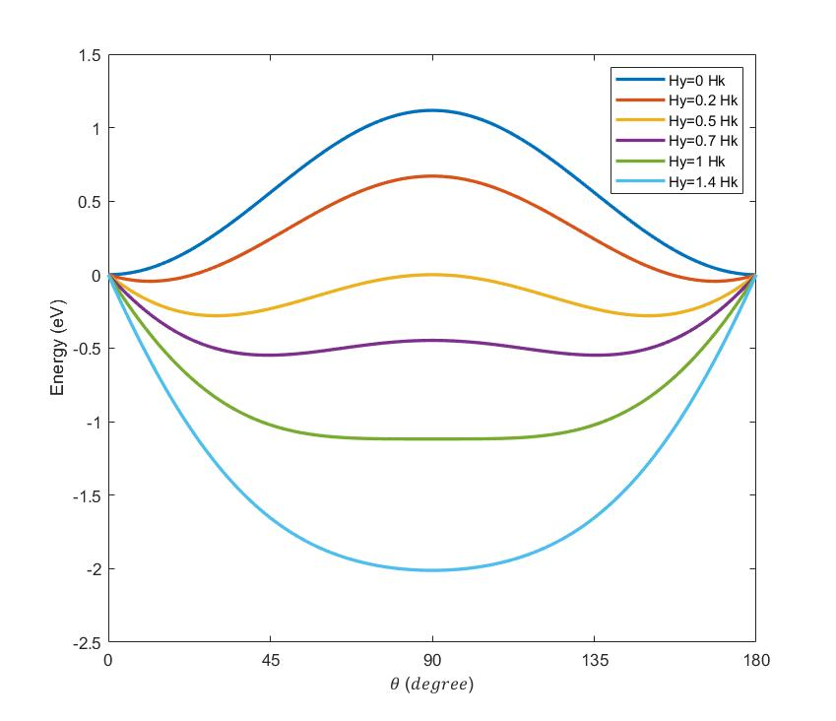
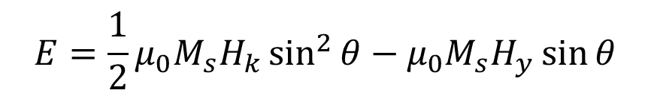
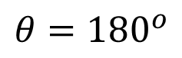
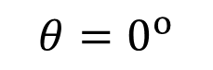
Potential Profiles H is along in-plane hard-axis
$$E=\frac{1}{2}μ_{0}M_{s}H_{k}\sin^{2}{θ}−μ_{0}M_{s}H_{y}\sin{θ}$$
H_{y} in along of in-plane hard axis
$$θ=0^{o}$$
H
$$θ={180}^{o}$$

Slide 13
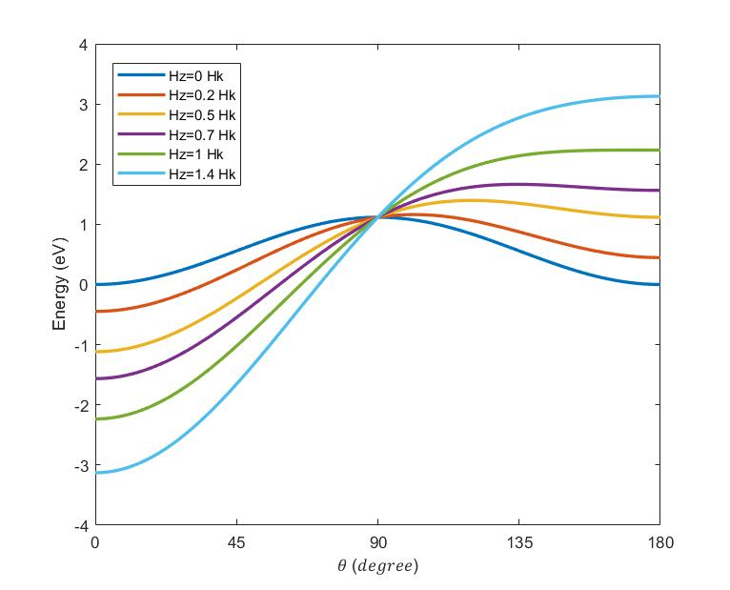
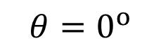
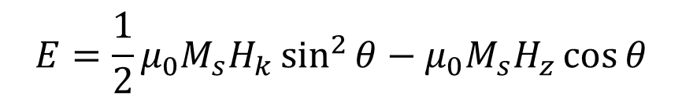
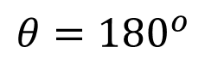
Potential profiles: H is along easy-axis
$$E=\frac{1}{2}μ_{0}M_{s}H_{k}\sin^{2}{θ}−μ_{0}M_{s}H_{z}\cos{θ}$$
H_{z} in along easy axis
$$θ=0^{o}$$
H
$$θ={180}^{o}$$

Slide 14
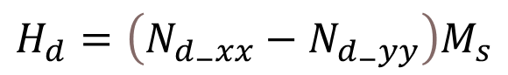
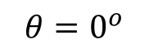
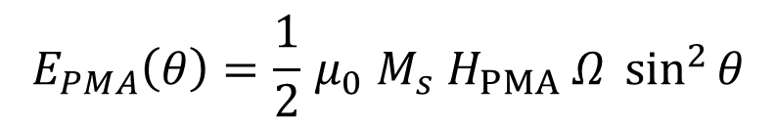
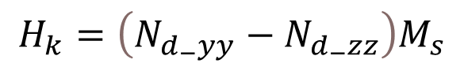
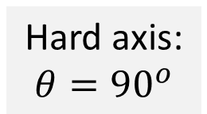











Perpendicular anisotropy
z
E_{shape} ($φ=±{90}^{o}$)
Easy axis:
$$θ=0^{o},{180}^{o}$$
z
Magnetization
direction
$$θ= 0^{o}$$
$$θ$$
Hard axis:
$$θ={90}^{o}$$
y
y
x
$$φ$$
$$θ={180}^{o}$$
$$θ=0^{o}$$
$$θ={180}^{o}$$
x
Energy barrier: 30-80 KT
(T=300 K)
Magnet’s plane: $φ =±90^{o}$
$$E_{shape}\left(θ,φ\right)=\frac{1}{2}{ μ}_{0 }M_{s }^{2}Ω{ N}_{d}\left(θ,φ\right)$$
$$N_{d}\left(θ,φ\right)=N_{d−xx}\sin^{2}{θ}\cos^{2}{φ}+{N_{d−yy}\sin^{2}{θ}sin}^{2}{φ}+{N_{d−zz} cos}^{2}{θ}$$
$$N_{d−xx}+N_{d_{−}yy}+N_{d−zz}=1$$
Circular cross-section
H_{PMA}$=H_{k}+H_{crystalline}+H_{interface}$
$$H_{d}=\left(N_{d_{−}xx}−N_{d_{−}yy}\right)M_{s}$$
$$=0$$
$$E_{PMA}\left(θ\right)=\frac{1}{2}{ μ}_{0 }M_{s}{ H}_{PMA} Ω\sin^{2}{θ}$$
$$H_{k}=\left(N_{d_{−}yy}−N_{d_{−}zz}\right)M_{s}$$

Slide 15







Perpendicular interface anisotropy
In-plane
sample
Out-of-plane
sample
z
$$N_{d_{−}zz}≫N_{d_{−}yy}≃1$$
$$k_{i}=1.3 mJ/m^{2}$$
MgO
Bulk
Interfacial anisotropy
$$tCoFeB<1.3 nm$$
$$\frac{K}{Ω}=\frac{1}{2}{ μ}_{0}M_{s}^{2}\left(N_{d_{−}yy}−N_{d_{−}zz}\right)+\frac{k_{i}}{tCoFeB}$$
y
CoFeB
x
Interface
$$\frac{K}{Ω}tCoFeB=−\left(\frac{1}{2}{ μ}_{0}M_{s}^{2}\right)tCoFeB+k_{i}$$
Ikeda, S. et al. "A perpendicular-anisotropy CoFeB–MgO magnetic tunnel junction."
Nature Materials 9 (2010) 721-724

Slide 16





Magnetization dynamics Landau-Lifshitz (LL) equation
precession
$α:$Phenomenological
damping parameter
$$\frac{ⅆM}{ⅆt}=−\left|γ\right| M×Heff −\frac{α\left|γ\right|}{M} M×M×Heff$$
damping
$$H_{eff}=−\frac{1}{M}∇E$$
$$M=μ_{0}M_{s}Ω$$
M= Magnetization
E= Potential energy
$Ω$=Volume
precession
Landau and Lifshitz, Phy. Z. Sowjet. 8, 101 (1935)
Damping causes a transfer of energy from macroscopic motion to microscopic thermal motion, which results in internal energy losses
Performance metrics
Switching delay and energy dissipation
A damping parameter takes into account the rate of energy transfer

Slide 17




Magnetization dynamics Landau-Lifshitz-Gilbert (LLG) equation
LL
$$\frac{ⅆM}{ⅆt}=−\left|γ\right|M×H_{eff}−\frac{α\left|γ\right|}{M}M×M×H_{eff}$$
LL cannot account for large damping in thin Permalloy sheets, adjusted by Gilbert
damping
LLG
$$\frac{ⅆM}{ⅆt}=−\left|γ\right|M×H_{eff}+\frac{α}{M}M×\frac{ⅆM}{ⅆt}$$
damping
In standard form
$$\left(1+α^{2}\right)\frac{ⅆM}{ⅆt}=−\left|γ\right|M×H_{eff}−\frac{α\left|γ\right|}{M}M×M×H_{eff}$$
LL
LLG
Gilbert, IEEE Trans. Magn. 40, 3443 (2004)
Notes:
Landau and Lifshitz formulated the theory of dynamics of magnetization in ferromagnetic bodies

Slide 18



Magnetization switching: Magnetic field
DOWN to UP
$$θ=0^{o}$$
(a)
(b)
(c)
(d)
$$θ={180}^{o}$$
z
Magnetic Random Access Memory (MRAM)
H_{y}
H_{z}
y
Huge energy dissipation to generate the magnetic field $107−108$ KT (~1 pJ)
Spin current
Voltage control
Magnetic field is difficult to confine in small space
Notes:
Why two magnetic field? If only one magnetic field Hz then we required high magnetic field and it may change neighbouring bit.

Slide 19






Giant Magneto-Resistance (GMR)
Giant Magneto-Resistance (GMR)
$$GMR=\frac{1−0.55}{0.55}×100≃80\%$$
$$\text{Fe}$$
$$\text{Cr}$$
$$\text{Fe}$$
1988
$$GMR=\frac{ΔR}{R}[\%]=\frac{RAP−RP}{R_{P}}×100$$
A. Fert, M.N Baibich et al., Phys. Rev. Lett. 61, 2472 (1988)
P. Grunberg, G. Binash et al., Phys. Rev. B 39, 4828 (1989)

Slide 20









Tunneling magneto-resistance (TMR)
Insulator
e.g., Al₂O₃, MgO
Conductance is proportional to the density of states
N_{L}↑, N_{R}↑, N_{L}↓, N_{R}↓
Left (L)
Right (R)
Left (L)
Right (R)
$$G^{↑↑}∝N_{L}^{↑}{ N}_{R}^{↑}$$
$$G^{↓↓}∝N_{L}^{↓}{ N}_{R}^{↓}$$
$$G^{↓↑}∝N_{L}^{↓}{ N}_{R}^{↑}$$
$$G^{↑↓}∝N_{L}^{↑}{ N}_{R}^{↓}$$
$$EF$$
$$TMR=\frac{GP−GAP}{GAP}$$
Reported 1975 (prior to GMR)
TMR>500% using MgO spacer
$${GAP=G}^{↓↑}+G^{↑↓}$$
$${GP=G}^{↑↑}+ G^{↓↓}$$
Julliere, M. Tunneling between ferromagnetic film. Phys. Lett. A 54, 225-226 (1975)
Moodera, J. S. et al., Phys. Rev. Lett. 74, 3273 (1995)
Mathon, J. et al., Phys. Rev. B 63, 220403 (2001), Butler, W. et al., Phys. Rev. B 63, 054416 (2001)
Yuasa, S. et al., Nature Mater. 3, 868 (2004), Parkin, S. et al., Nature Mater. 3, 862-867 (2004)

Slide 21







Spin-transfer-torque (STT)
Oliver E. Buckley Condensed Matter Physics Prize in 2013 “For predicting Spin-transfer torque ”
J. C. Slonczewski, J. Magn. Mater.159, L1 (1996)
Berger
Slonczewski
L. Berger, Phy. Rev. B 54, 9353 (1996)
1998: Experimentally
demonstrated
A spin-polarized current transfers its spin angular momentum to the magnetic body
Current density: 10⁷ A/cm²
Huge energy dissipation $106−108 KT (\sim 1 pJ)$
Ohmic $I2R$ dissipation
STT can rotate the magnetization axis of the nanomagnet
$$s=\left(ℏ/2ⅇ\right)ηI$$
$$η= \frac{I_{↑}−I_{↓}}{I_{↑}+I_{↓}}$$
$$STT=s{ n}_{m}×\left(n_{s}×n_{m}\right)=s\sin\left(ξ−θ\right){\hat{e}}_{θ}$$
Spin polarization

Slide 22


Switching nanomagnets with STT
$$s=\left(ℏ/2ⅇ\right)ηI$$
20 nm (circular cross-section)
Current passing through fixed magnet gets spin-polarized
Current: ~10 μA
Energy dissipation: ~1fJ

Slide 23

Spin Hall effect
Magnetic field
Magnetization
Spin-orbit
interaction
Pt, Ta,
W, CuBi
Non-magnets
Magnets
Non-magnets
Ordinary Hall effect
Hall voltage
NO
Spin accumulation
Anomalous Hall effect
Hall voltage
AND
Spin accumulation
(Pure) Spin Hall effect
NO Hall voltage
BUT
Spin accumulation
Hall voltage = 2
Spin accumulation = 0
Hall voltage = 1
Spin accumulation = 3
Hall voltage = 0
Spin accumulation = 2

Slide 24













Spin-orbit-torque (SOT)
Pure spin current
$$b$$
J_{c}
b $=10 nm, tSH=1 nm,Θ_{SH}=0.3$
$$\frac{I_{S}}{I_{C}}=3$$
$$A=\frac{π}{4}ab$$
Spin-Hall material
$$\frac{I_{s}}{I_{C}}=\frac{J_{s}}{J_{C}}\frac{A_{s}}{A_{C}}=Θ_{SH}\frac{ab}{{at}_{SH}}=Θ_{SH}\frac{b}{t_{SH}}$$
Charge
Spin
Spin-orbit interaction
Pt, Ta, W, CuBi
$$E=I_{C}^{2}RT={\left(\frac{t_{SH}I_{S}}{Θ_{SH}b}\right)}^{2}\left(ρ\frac{2}{π}\frac{b}{at_{SH}}\right)T=\left(\frac{1}{2}\frac{ρ}{Θ_{SH}^{2}}\right)\left(\frac{t_{SH}}{A}\right)I_{s}^{2}T$$
$$Js$$
$$(êz)$$
Material parameters
Dimension
$$\left\langle s\right\rangle$$
$$(êy)$$
Energy dissipation: ~0.1 fJ
$$− Jc$$
$$(êx)$$
Roy, K., J. Phys. D: Appl. Phys. (Fast Track Communication) 47 , 422001 (2014)

Slide 25









Spin-transfer-torque (Direct SHE) and Spin pumping (Inverse SHE)
$$\left\langle s\right\rangle$$
$$(êz)$$
$$Js$$
$$(êy)$$
$$− Jc$$
$$(êx)$$
Charge current generates spin current via direct SHE
Spin current exerts spin-transfer-torque on magnet
Precessing magnet injects pure spin current
Spin current generates charge current via inverse SHE
$$J_{s}=θ_{SH}\left\langle s\right\rangle ×J_{C}$$
Onsager’s reciprocity
$$J_{c}=θ_{SH}{ J}_{s}×\left\langle s\right\rangle$$

Slide 26









Ferromagnetic resonance with damping
precession
$$\frac{ⅆM}{ⅆt}=−\left|γ\right| M×Heff− \frac{α\left|γ\right|}{M} M×M×Heff$$
damping
Transverse AC field
$$Hy(t)=Hy0{ ⅇ}^{ⅈωt}$$
Negative damping to keep the magnetization rotating
$$ω=\left|γ\right| \sqrt{H_{z}\left(H_{z}+M\right)}$$
In-plane FMR
Derivative FMR spectra
$ω =\left|γ\right| (Hz−M$)
Perpendicular FMR
FMR linewidth $ΔH$
$$2 ΔH$$
Half width at half maximum (HWHM)
$$ΔH=\frac{αω_{0}}{\left|γ\right|}$$
$$ΔHpy=12.9 Oe$$

Slide 27





Spin pumping
An excited ferromagnet ejects spins into the adjacent materials
Increase in magnetization damping
Py
$$ΔH=12.9 Oⅇ$$
FMR linewidth $ΔH$
$$ΔH=\frac{αω_{0}}{\left|γ\right|}$$
Py
Pt
$$ΔH=16.9 Oⅇ$$
Increase in linewidth
Tserkovnyak et al., Phys. Rev. Lett. 88, 117601 (2002); Rev. Mod. Phys. 77 , 1375 (2005)
Mosendz et al. Phys. Rev. B 82,
1214403 (2010)

Slide 28
Contents
Introduction
Spintronics and nanomagnetics
Magnetic anisotropy
Magneto-resistance
Magnetization dynamics
Switching using magnetic field
Spin-transfer-torque
Spin Hall effect and spin-orbit-torque
Ferromagnetic resonance and spin pumping
Plan of works
Probing the resistivity of ultra-thin spin-orbit materials
Spin-torque ferromagnetic resonance
Switch magnetization using spin-orbit-torque
Experimental
Electron beam lithography and scanning electron microscopy (SEM)
Ferromagnetic resonance
Vibrating sample magnetometer (VSM)
X-Ray diffraction
Electrical characterization using probe station and accessories
Four-probe setup
Signal generator, oscilloscope, spectrum analyser, bias-tee and power supply
Atomic/Magnetic force microscopy (AFM/MFM)
Sputtering

Slide 29











Four-probe method
It allows to measure resistance excluding contact resistance
$$t≪s$$
$$s$$
We need to measure the resistivity of spin-orbit layer
$$ρ_{2D} =\frac{V}{I}\frac{πt}{ln⁡(2)}$$
$$ρ_{3D} =\frac{V}{I}2πs$$
$$\text{CoFeB}$$
$$Pt$$
$$R_{SH}=\frac{ρ}{t}=\frac{V}{I}\frac{π}{ln⁡(2)}$$
$$R_{SH,3D}=\frac{ρ}{t}$$
MgO
CoFeB
Notes:
It allows to measure resistance excluding contact resistance, because unwanted voltage drop because of contact resistance is removed during measurement of voltage difference between B and C.
In four probe measurement, all probes contact with material of unknown resistance. A DC current is force between the outer two probe, and a voltmeter measure the voltage difference between the inner two probes. The resistivity is calculated from geometric factor, the source current and the voltage measurement.

Slide 30






















Spin-torque ferromagnetic resonance (ST-FMR)
$$z$$
$$t$$
10 GHz
$$ω$$
2
$$VDC$$
6
$$J_{S}$$
$$w$$
$$θ$$
3
$$Jc(t)∼eiωt$$
in $x$-direction
$$m$$
4
~
$$y$$
5
$$z$$
1
$$l$$
Bias-Tee
$$H$$
100 KHz
Precessing
Magnetization
Spin Hall effect (SHE) layer
$$θ_{H}$$
$$m$$
$$θ$$
$$y$$
$$x$$
$$φ$$
In ST-FMR experiments, an alternating current in spin-orbit materials drives the magnetization precession in an adjacent magnet via direct spin Hall effect (SHE)
It pumps spins into the spin-orbit layer detected as a charge voltage/current via inverse spin Hall effect (ISHE)
RF signal generator, spectrum analyzer and electromagnet
Bias-Tee: Simultaneous application of AC and detection of DC
30

Slide 31










Switching perpendicular magnets
Magnetization can rotate only in $90^{o}$ direction
$$Js$$
$$(êz)$$
van den Brink et al APL 104, 012403 (2014)
Fixed Layer
Insulator
$$\left\langle s\right\rangle$$
$$(êy)$$
Free Layer
Does not help much compared to ONLY using J_{STT}
$$− Jc$$
$$(êx)$$
J_{s}
J_{c}
Passing perpendicular J_{STT}
Issue with switching perpendicular nanomagnets
Tilted anisotropy
Lateral asymmetry
You et al, PNAS 112, 10310 (2015)
Yu et al, Nature Nano 9, 548 (2014)
Difficult to create gradient experimentally
in small 10 nm dimensions
Issue with scaling

Slide 32
Contents
Introduction
Spintronics and nanomagnetics
Magnetic anisotropy
Magneto-resistance
Magnetization dynamics
Switching using magnetic field
Spin-transfer-torque
Spin Hall effect and spin-orbit-torque
Ferromagnetic resonance and spin pumping
Plan of works
Probing the resistivity of ultra-thin spin-orbit materials
Spin-torque ferromagnetic resonance
Switch magnetization using spin-orbit-torque
Experimental
Electron beam lithography (EBL) and scanning electron microscopy (SEM)
Ferromagnetic resonance (FMR)
Vibrating sample magnetometer (VSM)
Electrical characterization using probe station and accessories
Four-probe setup
Signal generator, oscilloscope, spectrum analyser, bias-tee and power supply
X-Ray diffraction (XRD)
Atomic/Magnetic force microscopy (AFM/MFM)
Sputtering

Slide 33



Scanning electron microscope (SEM)
It was developed due to the limitation of optical microscope
SEM is used to visualize the surface of an object
(a)
(b)
Field-emission electron gun
Illustration of resolution in (a) Airy disk and (b) wave front.
Notes:
Scanning electron microscopes are scientific instruments that use a beam of energetic electrons to examine object on a very fine scale. SEM used to visualize the surface of an object. SEM was developed due to the limitation of Light Microscopes.
SEM uses a focused electron beam over a surface to create an image. The electrons interact with the atom that make up the sample producing signals that contain information about the sample’s surface topography, and different properties like composition of materials. SEM scan the surface of the specimen systematically, producing large number of signals. These electron signals are eventually converted to a visual signal displayed on a cathode ray tube (CRT). SEM is a type of electron microscope that images a sample by scanning it with a high energy beam of electron in a raster scan pattern.

Slide 34
Working principle of SEM
The electrons interact with the atom that make up the sample producing signals that contain information about the sample
Electron source
Anode
Condenser lens
Scan coil
Backscatter electron detector
Secondary electron detector
Objective lens
Sample
Basic components of SEM
Notes:
Electron microscopes are scientific instruments that use a beam of energetic electrons to examine object on a very fine scale. SEM used to visualize the surface of an object. SEM was developed due to the limitation of Light Microscopes.
SEM uses a focused electron beam over a surface to create an image. The electrons interact with the atom that make up the sample producing signals that contain information about the sample’s surface topography, and different properties like composition of materials. SEM scan the surface of the specimen systematically, producing large number of signals. These electron signals are eventually converted to a visual signal displayed on a cathode ray tube (CRT). SEM is a type of electron microscope that images a sample by scanning it with a high energy beam of electron in a raster scan pattern.

Slide 35


Electronic beam lithography (EBL)
Resist layer
Draw patterns
Substrate
Exposure with e-beam
Positive-resist: PMMA
For achieving 100 nm thickness:
0.9 ml PMMA for 2 inch wafer
At 500 RPM for 5 s for spreading and then 2100 RPM for 30 s
Pre bake: ${180}^{o}C$ for 90 s
Development
Metal deposition
For development:
IPA+MIBK with 3:1 for 30 s
IPA for 30 s
Lift-off
Metal deposition: Sputtering
Lift-of: Acetone for 10 s in ultrasonic cleaner
Notes:
PMMA: Polymethyl methacrylate, IPA: Isopropyl alcohol

Slide 36










EBL result
I have seen 5 nm gold structure in SEM
Measured thickness of resist layer
Draw the pattern in EBL software
Fabricated both draw pattern and standard pattern
100 nm
20 nm
Gold standard 617 sample
Gold standard 617_3 sample
200 nm
20 $μ$m
2 $μ$m
20 $μ$m
Thickness measurement
in SEM
Different structures after EBL

Slide 37



Vibrating sample magnetometer (VSM)
Highly sensitive magnetic moment measurement device.
Magnetic field up to ~70k Oe (7 T)
Works on the basic principle of Faraday’s law
$$E=−N\frac{ⅆφ}{ⅆt}$$
M
Sample rod
Adaptor
Sample
H
Co 5 nm sample
Notes:
SQUID-VSM ( Superconducting Quantum Interface Device Vibrating Sample Magnetometer)

Slide 38













Vibrating sample magnetometer (VSM)
In-plane samples
E($θ$,$φ$)
Out of plane energy
barrier goes higher
Energy
$$θ$$
Rotate from the top
z
$$\text{φ}$$
$$φ =90o$$
$$0o≤φ≤{360}^{o}$$
H
$$θ=0o$$
$$0o≤θ≤{180}^{o}$$
z
z
z
z
H
H
H
H
M
M
M
M
y
M
x
y
y
y
y
x
x
x
x
For $θ$ rotation,
rotate sample clockwise
For $φ$rotation,
rotate rod anticlockwise
$$φ={90}^{o}$$
$$θ={90}^{o}$$
Notes:
Magnitude of a circulation of electric field around a closed loop is equal to the rate of change of the magnetic flux through the are enclosed by the loop.

Slide 39












Vibrating sample magnetometer (VSM)
z
Energy
Out of plane energy
barrier goes higher
M
H
E($θ$,$φ$)
$$θ$$
Out-of-plane samples
$$\text{φ}$$
y
$$θ=0o$$
$$0o≤θ≤{180}^{o}$$
$$φ=0o$$
$$0o≤φ≤{360}^{o}$$
x
z
z
y
y
H
H
H
H
M
z
x
y
y
x
x
x
z
z
M
H
M
M
y
For $θ$ rotation, tilt the sample by using glass pieces
For$φ$ rotation,
rotate sample
x
$$φ={90}^{o}$$
$$θ={90}^{o}$$
Notes:
Magnitude of a circulation of electric field around a closed loop is equal to the rate of change of the magnetic flux through the are enclosed by the loop.

Slide 40













Ferromagnetic resonance (FMR)
In-plane samples
Energy
Out of plane energy
barrier goes higher
$$θ$$
E($θ$,$φ$)
$$\text{φ}$$
Rotate from the top
$$θ=0^{o}$$
$$0o≤θ≤{180}^{o}$$
x
x
$$φ={90}^{o}$$
$$0o≤φ≤{360}^{o}$$
z
z
H
H
z
H
H
H
M
M
M
z
M
M
z
y
y
y
y
x
x
x
y
For $θ$ rotation, rotate sample anti-clockwise
For $φ$rotation, rotate rod in anticlockwise
$$φ={90}^{o}$$
$$θ={90}^{o}$$
Notes:
Magnitude of a circulation of electric field around a closed loop is equal to the rate of change of the magnetic flux through the are enclosed by the loop.

Slide 41











Ferromagnetic resonance (FMR)
Out-of-plane samples
Out of plane energy
barrier goes higher
Energy
E($θ$,$φ$)
$$θ$$
$$\text{φ}$$
$$θ=0^{o}$$
$$0o≤θ≤{180}^{o}$$
$$φ={90}^{o}$$
x
y
$$0o≤φ≤{360}^{o}$$
x
y
H
H
H
H
H
M
M
z
z
x
x
y
y
z
z
M
M
For $θ$ rotation, tilt the sample by using glass pieces
For $φ$rotation,
rotate sample
$$φ={90}^{o}$$
$$θ={90}^{o}$$
Notes:
Magnitude of a circulation of electric field around a closed loop is equal to the rate of change of the magnetic flux through the are enclosed by the loop.

Slide 42
Thank you

Slide 43
I have done
Wafer cleaning, cutting and trimming
Spin coating (achieved 100 nm thickness)
Measured the sample thickness in SEM
Electron beam lithography
Imaging in SEM and TEM
EDX
Magnetize sample by using Electromagnet
Vibrating sample magnetometer (VSM)
Ferromagnetic resonance on hard disc sample
Anneal the sample at high temperature
Measure electrical characteristics by using probe station
Making waveguide for ST-FRM setup
Generate signal from signal generator and record waveforms on spectrum analyzer.

Slide 44

LL and LLG

Slide 45

FMR

Slide 46

FMR

Slide 47

FMR

Slide 48

FMR

Slide 49

FMR

Slide 50



FMR
Derivative FMR spectra
FMR linewidth $ΔH$
Half width at half maximum (HWHM)
$$ΔH=\frac{αω_{0}}{\left|γ\right|}$$
$$2 ΔH$$
$$ΔHpy=12.9 Oe$$

Slide 51

SAF: Interlayer exchange coupling
SAF: Synthetic antiferromagnetic layer

Slide 52








Four-probe method
$$ρ_{3D} =\frac{V}{I}×2πs$$
For equal spacing
$$ρ_{2D} =\frac{V}{I}×\frac{πt}{ln⁡(2)}$$
(◦) Experimental data
(-) statistical model
(- --) Basis of fit parameters
$$R_{SH}=\frac{ρ}{t}$$
$$ρ_{3D}=\frac{V}{I}×\frac{2π}{\left(\frac{1}{s_{1}}−\frac{1}{s_{2}}\right)−\left(\frac{1}{s_{3}}−\frac{1}{s_{4}}\right)}$$
For unequal spacing
$$ρ_{2D}=\frac{V}{I}×\frac{2πt}{ln⁡\left(\frac{s_{2} s_{3}}{s_{1} s_{4}}\right)}$$
Schmiedl, E et al. (2008). The electrical resistivity of ultra-thin copper films. Zeitschrift für Naturforschung A, 63(10-11), 739-744.
Notes:
In four probe measurement, all probes contact with material of unknown resistance. A DC current is force between the outer two probe, and a voltmeter measure the voltage difference between the inner two probes. The resistivity is calculated from geometric factor, the source current and the voltage measurement.

Slide 53








ST-FMR setup
Signal generator
Bias-Tee
Oscilloscope
Spectrum-analyzer waveform
Waveguide and
gauss probe
Electromagnet

Slide 54

Single-domain and Multi-domain

Slide 55


Depth of field
Depth of field at different working distance
Different electrons
Working distance: Distance from the final pole piece of the lens to the sample when the image is in focus.
Depth of focus: The portion of the image that appears acceptably in focus is called the depth of focus.

Slide 56
Contents
Introduction
Spintronics and nanomagnetics
Magnetic anisotropy
Magneto-resistance
Magnetization dynamics
Switching using magnetic field
Spin-transfer-torque
Spin Hall effect and spin-orbit-torque
Ferromagnetic resonance and spin pumping
Plan of works
Probing the resistivity of ultra-thin spin-orbit materials
Spin-torque ferromagnetic resonance
Switch magnetization using spin-orbit-torque
Experimental
Electron beam lithography (EBL) and scanning electron microscope (SEM)
Ferromagnetic resonance (FMR)
Vibrating sample magnetometer (VSM)
X-Ray diffraction (XRD)
Transmission electron microscope (TEM)
Atomic/Magnetic force microscope (AFM/MFM)
Sputtering
Electrical characterization using probe station and accessories
Four-probe setup
Signal generator, oscilloscope, spectrum analyser, bias-tee and power supply

Slide 57



H_{y} vs θ_{min}
H_{y} in along of in-plane hard axis
$$E=\frac{1}{2}μ_{0}M_{s}H_{k}\sin^{2}{θ}−μ_{0}M_{s}H_{y}\sin{θ}$$
$$\sin{θ_{min}}=\frac{H_{y}}{H_{k}}$$

Slide 58

Spin-transfer-torque (Direct SHE) and Spin pumping (Inverse SHE)
Charge current generates spin current via direct SHE
Spin current exerts spin-transfer-torque on magnet
Precessing magnet injects pure spin current
Spin current generates charge current via inverse SHE
$$J_{s}=θ_{SH}\left\langle s\right\rangle ×J_{C}$$
Onsager’s reciprocity
$$J_{c}=θ_{SH}{ J}_{s}×\left\langle s\right\rangle$$

